Slide 1
Chapter 3
The basic relational model

Slide 2
Chapter 3 Outline
The Relational Data Model and Relational Database Constraints
Relational Model Constraints and Relational Database Schemas
Update Operations, Transactions, and Dealing with Constraint Violations

Slide 3
The Relational Data Model and Relational Database Constraints
Relational model
First commercial implementations available in early 1980s
Has been implemented in a large number of commercial system

Slide 4
Relational Model Concepts
Represents data as a collection of relations
Table of values
Row
Represents a collection of related data values
Fact that typically corresponds to a real-world entity or relationship
Tuple
Table name and column names
Interpret the meaning of the values in each row attribute

Slide 5
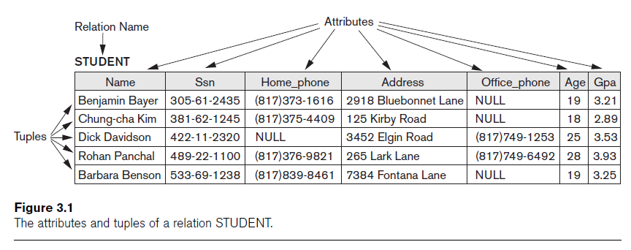
Relational Model Concepts (cont’d.)

Slide 6
Domains, Attributes, Tuples, and Relations
Domain D
Set of atomic values
Atomic
Each value indivisible
Specifying a domain
Data type specified for each domain

Slide 7
RM Terminology
Relation: table with columns and rows.
Attribute: named column of a relation.
Domain: set of allowable values for one or more attributes.
Tuple: a record of a relation.
Relational Database - collection of normalized relations with distinct relation names.

Slide 8
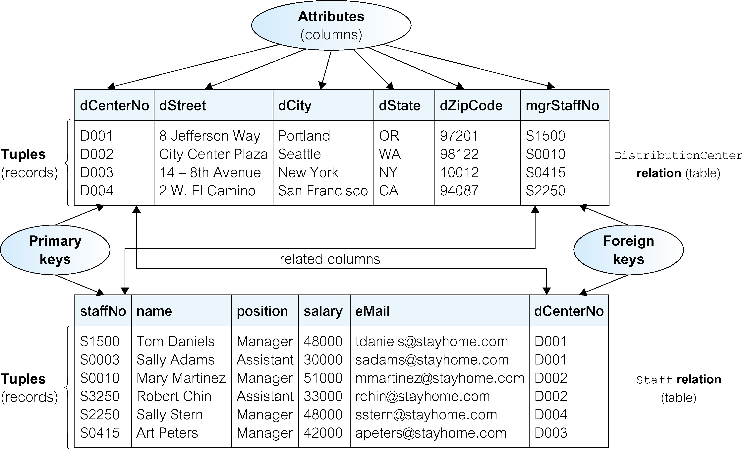
Instances of DistributionCenter and Staff relations

Slide 9
Domains for some attributes of distributionCenter and staff relations

Slide 10
Properties of Relational Tables
Table name is distinct from all other table names in the database.
Each cell of table contains exactly one atomic (single) value.
Each column has a distinct name.
Values of a column are all from the same domain.
Each record is distinct; there are no duplicate records.
Order of columns has no significance.
Order of records has no significance, theoretically.

Slide 11
Relational Keys
Superkey
A column, or a set of columns, that uniquely identifies a record within a table.
Candidate Key
A superkey that contains only the minimum number of columns necessary for unique identification.
In each record, values of the candidate key uniquely identify that record (uniqueness).
No proper subset of the candidate key has the uniqueness property (irreducibility).

Slide 12
Relational Keys
Composite Key
A key consists of more than one column
Primary Key
The candidate key that is selected to identify records uniquely within table.
Alternate Keys
Candidate keys that are not selected to be primary key.
Foreign Key
Column, or set of columns, within one table that matches the candidate key of some (possibly the same) table.

Slide 13
Relational Integrity
Nulls
Represents value for a column that is currently unknown or not applicable for record.
Deals with incomplete or exceptional data.
Represents the absence of a value and is not the same as zero or spaces, which are values.

Slide 14
Relational Integrity
Entity Integrity
In a base table, no column of a primary key can be null.
Referential Integrity
If a foreign key exists in a table, either foreign key value must match a candidate key value of some record in its home table or foreign key value must be wholly null.
Integrity Constraints
Rules that define or constrain some aspect of the data used by the organization.

Slide 15
Domains, Attributes, Tuples, and Relations (cont’d.)
Relation schema R
Denoted by R(A₁, A₂, ...,A_{n})
Made up of a relation name R and a list of attributes, A₁, A₂, ..., A_{n}
Attribute A_{i}
Name of a role played by some domain D in the relation schema R
Degree (or arity) of a relation
Number of attributes n of its relation schema

Slide 16
Domains, Attributes, Tuples, and Relations (cont’d.)
Relation (or relation state)
Set of n-tuples r = {t₁, t₂, ..., t_{m}}
Each n-tuple t
Ordered list of n values t =<v₁, v₂, ..., v_{n}
Each value v_{i}, 1 ≤ i ≤ n, is an element of dom(A_{i}) or is a special NULL value

Slide 17
Domains, Attributes, Tuples, and Relations (cont’d.)
Cardinality
Total number of values in domain
Current relation state
Relation state at a given time
Reflects only the valid tuples that represent a particular state of the real world
Attribute names
Indicate different roles, or interpretations, for the domain

Slide 18
Characteristics of Relations
Ordering of tuples in a relation
Relation defined as a set of tuples
Elements have no order among them
Ordering of values within a tuple and an alternative definition of a relation
Order of attributes and values is not that important
As long as correspondence between attributes and values maintained

Slide 19
Characteristics of Relations (cont’d.)

Slide 20
Relational Model Notation
Relation schema R of degree n
Denoted by R(A₁, A₂, ..., A_{n})
Uppercase letters Q, R, S
Denote relation names
Lowercase letters q, r, s
Denote relation states
Letters t, u, v
Denote tuples

Slide 21
Relational Model Notation
Name of a relation schema: STUDENT
Indicates the current set of tuples in that relation
Notation: STUDENT(Name, Ssn, ...)
Refers only to relation schema
Attribute A can be qualified with the relation name R to which it belongs
Using the dot notation R.A

Slide 22
Relational Model Notation
n-tuple t in a relation r(R)
Denoted by t = <v₁, v₂, ..., v_{n}>
v_{i} is the value corresponding to attribute A_{i}
Component values of tuples:
t[A_{i}] and t.A_{i} refer to the value v_{i} in t for attribute A_{i}
t[A_{u}, A_{w}, ..., A_{z}] and t.(A_{u}, A_{w}, ..., A_{z}) refer to the subtuple of values <v_{u}, v_{w}, ..., v_{z}> from t corresponding to the attributes specified in the list

Slide 23
Relational Model Constraints
Constraints
Restrictions on the actual values in a database state
Derived from the rules in the miniworld that the database represents
Inherent model-based constraints or implicit constraints
Inherent in the data model

Slide 24
Domain Constraints
Typically include:
Numeric data types for integers and real numbers
Characters
Booleans
Fixed-length strings
Variable-length strings
Date, time, timestamp
Money
Other special data types

Slide 25
Key Constraints and Constraints on NULL Values
No two tuples can have the same combination of values for all their attributes.
Superkey
No two distinct tuples in any state r of R can have the same value for SK
Key
Superkey of R
Removing any attribute A from K leaves a set of attributes K that is not a superkey of R any more

Slide 26
Key Constraints and Constraints on NULL Values (cont’d.)
Key satisfies two properties:
Two distinct tuples in any state of relation cannot have identical values for (all) attributes in key
Minimal superkey
Cannot remove any attributes and still have uniqueness constraint in above condition hold

Slide 27
Key Constraints and Constraints on NULL Values (cont’d.)
Candidate key
Relation schema may have more than one key
Primary key of the relation
Designated among candidate keys
Underline attribute
Other candidate keys are designated as unique keys

Slide 28
Key Constraints and Constraints on NULL Values (cont’d.)

Slide 29
Relational Databases and Relational Database Schemas
Relational database schema S
Set of relation schemas S = {R₁, R₂, ..., R_{m}}
Set of integrity constraints IC
Relational database state
Set of relation states DB = {r₁, r₂, ..., r_{m}}
Each r_{i} is a state of R_{i} and such that the r_{i} relation states satisfy integrity constraints specified in IC

Slide 30
Relational Databases and Relational Database Schemas (cont’d.)
Invalid state
Does not obey all the integrity constraints
Valid state
Satisfies all the constraints in the defined set of integrity constraints IC

Slide 31
Integrity, Referential Integrity, and Foreign Keys
Entity integrity constraint
No primary key value can be NULL
Referential integrity constraint
Specified between two relations
Maintains consistency among tuples in two relations

Slide 32
Integrity, Referential Integrity, and Foreign Keys (cont’d.)
Foreign key rules:
The attributes in FK have the same domain(s) as the primary key attributes PK
Value of FK in a tuple t₁ of the current state r₁(R₁) either occurs as a value of PK for some tuple t₂ in the current state r₂(R₂) or is NULL

Slide 33
Integrity, Referential Integrity, and Foreign Keys (cont’d.)
Diagrammatically display referential integrity constraints
Directed arc from each foreign key to the relation it references
All integrity constraints should be specified on relational database schema

Slide 34
Update Operations, Transactions, and Dealing with Constraint Violations
Operations of the relational model can be categorized into retrievals and updates
Basic operations that change the states of relations in the database:
Insert
Delete
Update (or Modify)

Slide 35
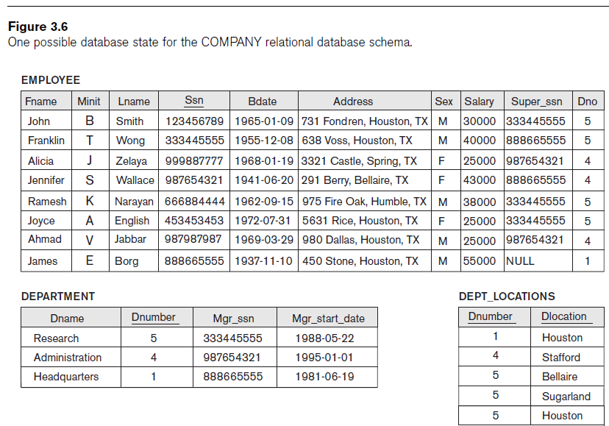

Slide 36
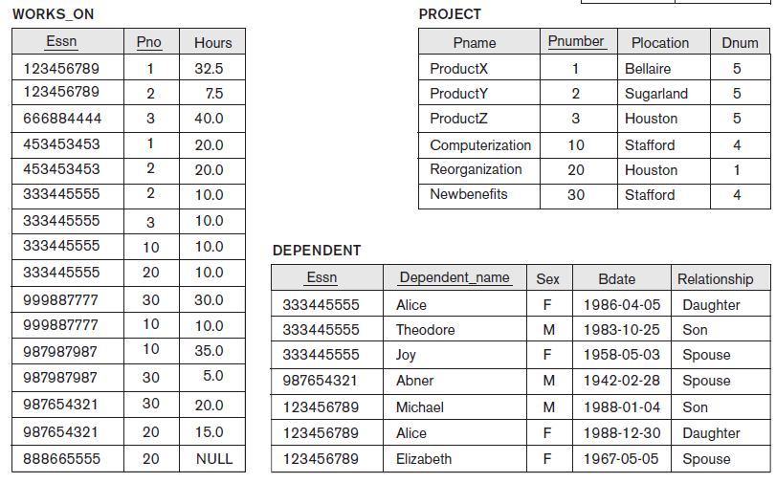

Slide 37
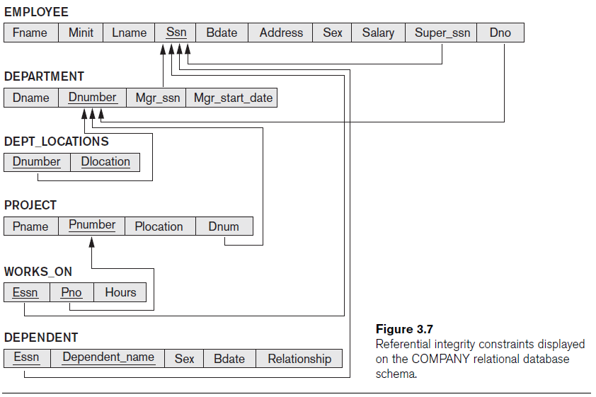

Slide 38
The Insert Operation
Provides a list of attribute values for a new tuple t that is to be inserted into a relation R
Can violate any of the four types of constraints
If an insertion violates one or more constraints
Default option is to reject the insertion

Slide 39
The Delete Operation
Can violate only referential integrity
If tuple being deleted is referenced by foreign keys from other tuples
Restrict
Reject the deletion
Cascade
Propagate the deletion by deleting tuples that reference the tuple that is being deleted
Set null or set default
Modify the referencing attribute values that cause the violation

Slide 40
The Update Operation
Necessary to specify a condition on attributes of relation
Select the tuple (or tuples) to be modified
If attribute not part of a primary key nor of a foreign key
Usually causes no problems
Updating a primary/foreign key
Similar issues as with Insert/Delete

Slide 41
The Transaction Concept
Transaction
Executing program
Includes some database operations
Must leave the database in a valid or consistent state
Online transaction processing (OLTP) systems
Execute transactions at rates that reach several hundred per second

Slide 42
Summary
Characteristics differentiate relations from ordinary tables or files
Classify database constraints into:
Inherent model-based constraints, explicit schema-based constraints, and application-based constraints
Modification operations on the relational model:
Insert, Delete, and Update

